Slide 1

Criminal Facial Recognition using AI ,Deep learning & Machine Learning
Notes:
"Imagine a world where a single camera in an airport, railway station, or public street can instantly identify a wanted criminal and alert law enforcement—before a crime even happens. This is no longer science fiction. Today, I will show you how our AI-powered Criminal Facial Recognition System is making this possible."

Slide 2
Team Name : Pixel Patrol
Team Members :
Deeksha Raj M N [Research, Wireframe & Design] 7483737778
Rahitya [Core Development] 8792465455
Team Captain :
Arshad Pasha [Project Lead- Full Implementation plan] 7760554350
College : Seshadripuram Degree College, Mysuru

Slide 3
Team Name :PixelPatral
Arshad Pasha [Project Lead- Full Implementation plan] 7760554350
College : Seshadripuram Degree College, Mysuru

Slide 4

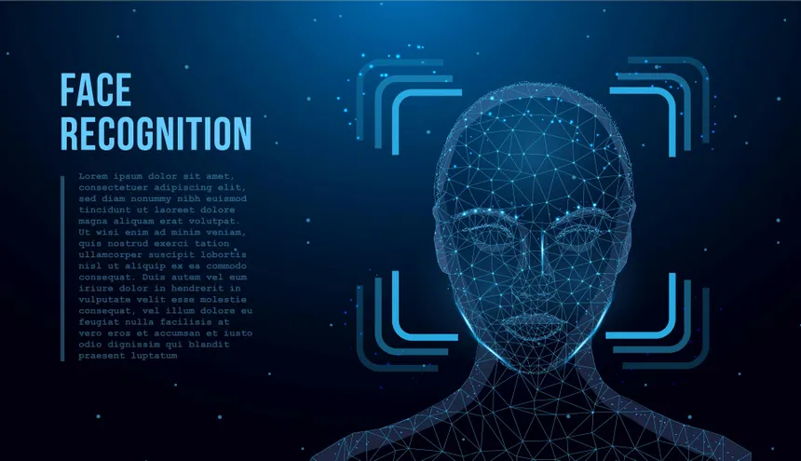

Slide 5
Project Summary
Objective:
To develop an AI-powered Criminal Facial Recognition System for law enforcement.
Technology Used:
AI, Deep Learning, and Machine Learning for accurate facial identification.
Functionality:
Captures and analyzes facial features from surveillance footage.
Matches detected faces against a criminal database.
Triggers instant SMS and sound alerts when a match is found.
Impact:
Enhances crime detection efficiency and reduces investigation time.
Provides real-time automated suspect identification for law enforcement.
Improves public safety with quick and reliable criminal recognition.

Slide 6
Introduction
What is Facial Recognition?
Facial recognition is a biometric technology that identifies or verifies individuals based on their facial features.
It analyzes patterns based on a person’s facial textures and shapes.
Aim of the System
“To develop an intelligent system capable of recognizing criminals using AI & ML algorithms.”

Slide 7
Problem Statement
Increasing crime rates require faster and more accurate identification methods.
Manual identification is time consuming, slow, error-prone, and inefficient in fast paced environments.
Developing an AI – ML powered system for real time , accurate criminal identification to enhance public safety and assist law enforcement.

Slide 8
Case Study
Case 1️⃣ – Mumbai Terror Attacks (2008)
The terrorists walked freely through CCTV-covered areas, but no system could identify them in real time.
Solution: If our system had been in place, law enforcement would have been alerted instantly, potentially preventing the attack.
Case 2️⃣ – Missing Persons & Human Trafficking
Every year, millions go missing worldwide, and many are trafficked.
Solution: Our system can scan crowds, public places, and transit hubs, instantly identifying missing persons from databases.

Slide 9
Objectives and Solution Overview
To detect and recognize faces of criminals from
images or videos.
To integrate AI/ML for high accuracy recognition.
To assist law enforcement in reducing crime
Centralized criminal records platform
Facial recognition integration
Real time SMS notifications
Faster more accurate investigations

Slide 10
Key Features
Real – Time Facial Detection
High Accuracy Recognition
Criminal Database Matching
Automated Alerts
Scalability
Emotion & Behavior Analysis
Data Logging & Reporting

Slide 11
When a surveillance camera captures an image, the system detects faces and extracts key features. These features are then matched against a centralized criminal database. If a criminal match is found, the system triggers real-time alerts via SMS and sound notifications, enabling law enforcement to respond immediately.
Image Capture
Face Detection
Feature Extraction
The system captures images, detects faces, and extracts key features for matching against a criminal database. If a match is found, it sends real-time SMS and audio alerts to law enforcement.
Face Matching
Alert / Output

Slide 12
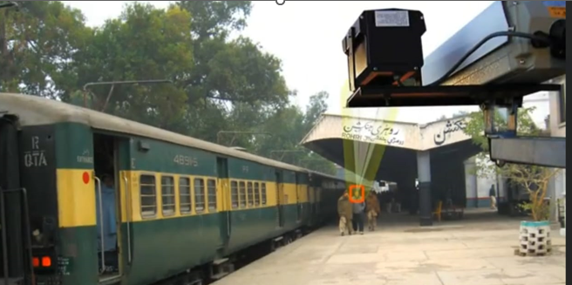

Slide 13
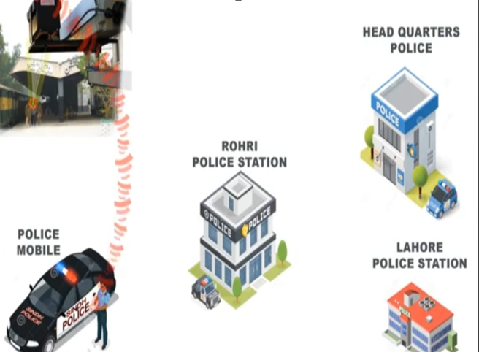

Slide 14
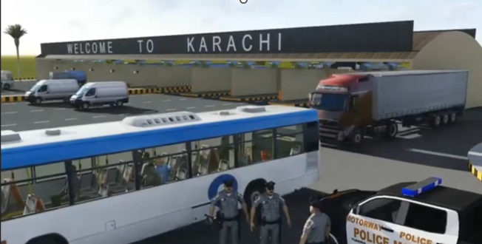

Slide 15
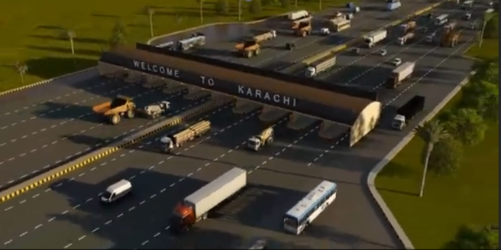

Slide 16
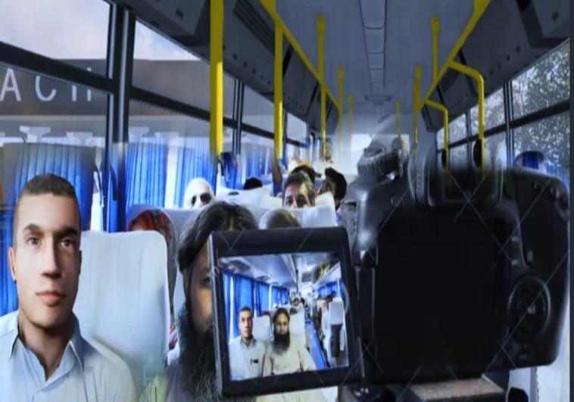

Slide 17
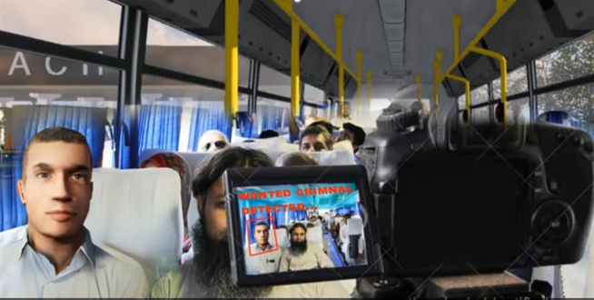

Slide 19
How It Works – Step-by-Step Process
Image / Video Input
Face Detection(Haar cascade, CNN, etc.)
Feature Extraction(Landmarks, embeddings)
Face Matching(using ML classifiers like SVM, KNN or Deep Learning like CNNs
Output: Identified Person/ Criminal Database Match

Slide 20






Technology Stack / Tech Stack (Tools Behind the Solution)
Built using Python
Integrates key libraries & APIs
Frontend : Tkinter GUI
Backend : Python logic
Database : SQLite
APIs : SMS API
Other : OpenCV and Playsound

Slide 21
Technical Challenges
Facial recognition accuracy
Efficient database management
Real – time SMS integration
Performance optimization

Slide 22
Innovation & Impact
Innovation Aspects
Impact
Real – time facial recognition & SMS integration.
Immediate alerts for faster response
Unique combination of technologies
Adaptive Learning Algorithms
Privacy & Ethical safeguards
Enhanced Public Safety
Reduced Workload for Officers
Improved trust in the Justice System
Faster Case Resolutions
Cost – Effective Law Enforcement
Deterrence of Criminals Activities.

Slide 23
Target Users & Benefits
Target Users
1. Law Enforcement
2. Government agencies
3. Security firms
Potential Benefits
1. Faster suspect identification
2. Improved accuracy
3. Streamlined operations

Slide 24
Implementation plan
Phase | Timeframe | Deliverables | Team Members
Research, Wireframe & Design | 2 Days | Wireframes, Design Documents | Arshad Pasha
Core Development | 6 Days | Functional Code, Initial Version | Arshad Pasha
Testing & Iteration | 1 Day | Bug Reports, Improvements | Arshad Pasha
Final Polish & Demo Prep | 3 Days | Refined Code, Demo Presentation | Arshad Pasha

Slide 25
Future Scope
Integration with smart city surveillance with Live
AI based behaviour analysis
Emotion detection
Multi – modal biometric systems
E.G:- Voice + Face + Infrared Sensors

Slide 26
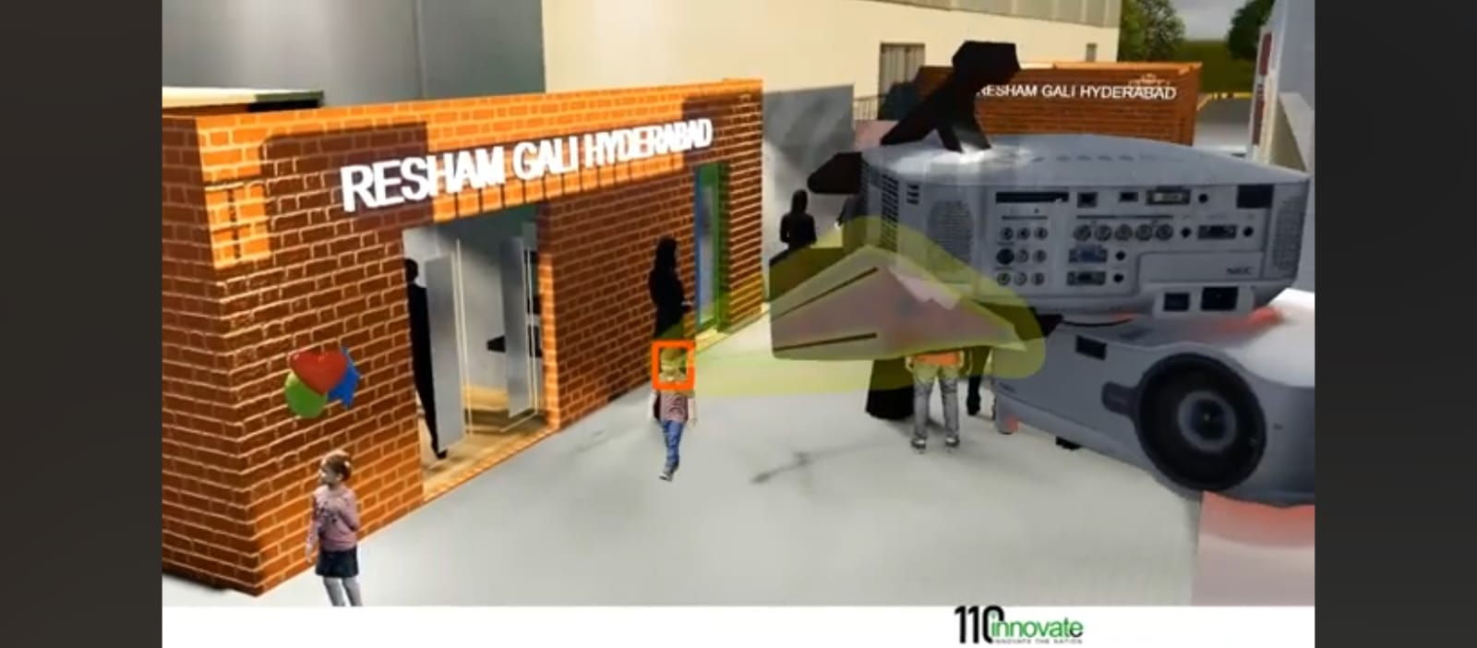

Slide 27
Demo or Prototype
https://youtu.be/0lMsasNGoFA?si=YgLsLk0gU8VAVbxO
"The above link demonstrates the design and operation of our Criminal Facial Detection System."

